Slide 1
Police Administration System
Prepared by: Arman Mann 13BCE0073
Abhirup Mukherjee 13BCE0076
Anirudh Dahiya 13BCE0606

Slide 2
Abstract
The Police Administration System is a web application maintained by police stations across a small region. There are two basic users: Police officers in local police stations and Police Officers in the Head Office. The Police Administration System provides functionalities like Passport Verification, Traffic Fine Registration and Payment, displaying Criminal List, FIR Registration and Message Broadcasting. Head Office police officers can update the criminal database and acts as the final authority in sending a passport application to the Passport Office. The Police Administration System does away with the model of written records and files as everything is computerized. Registers of FIR complaints as well as documents for passport verification need not be maintained anymore as everything is now done via a database maintained on a server. The Police Administration System serves the objective of being efficient and reliable (in terms of fine collection and storing data).

Slide 3
Process Model
The process model implemented is the Incremental Model. This is a method of software development where the product is designed, implemented and tested incrementally (a little more is added each time) until the product is finished. It involves both development and maintenance. The product is defined as finished when it satisfies all of its requirements. This model combines the elements of the waterfall model with the iterative philosophy of prototyping.
The incremental model allows to add functionalities to the project via Increments. It allows us to get a working model quickly and then evolve the model by adding increments. After each iteration, testing is conducted. During this testing, faulty elements of the software can be quickly identified. Customer can respond to features and review the product for any needful changes.

Slide 4
Functional Requirements
Registration: This module allows first time users to register to use the administration site. Each registration is vetted by the admin of the website before being allowed to use the system.
Login: This module allows user to log into the system to avail the exclusive functionalities available to registered and verified police officers.
Traffic Fine Registration: This module is to allow police officers to register traffic offenders. A form asks for the name of the offender, the receipt number assigned to him/her, the offence committed and the amount to be paid by the offender.
Traffic Fine Payment: This module is to confirm payment of traffic fine payments. A form asks for the receipt number on the receipt issued to the violator. The database is searched for that particular receipt. If the status of the receipt is unpaid in the table, then the status is changed as payment has been received by the police officer at the desk. If the receipt doesn’t exist or a receipt number has been entered who’s status is already paid, appropriate message is displayed.

Slide 5
Functional Requirements
FIR Registration: This module allows the lodging of an FIR complaint. A form takes in details from the victim such as name, address, criminal details and the form is submitted. There is also a facility for the police to view previously filed FIRs.
Criminal List: This is a page which lists pictures and details of the wanted criminals. Local police stations can only view the list. Head office police station has credentials to update it. The initial page allows us to click on individual criminal pictures to get detailed view.
Message Broadcast: The message broadcasting module allows sending of messages between a police officer and the entire station.
Passport Verification: This is a two tier confirmation module. The local police station has a police officer who fills in the confirmation form which includes checking for proper documents to confirm whether the applicant is a citizen of India. Once the form is submitted, a police officer in the head office checks the form one last time and then forwards it to the passport office.

Slide 6
Non Functional Requirements
Response Time: The maximum response time for the submission of a job will be 1 seconds.
Bandwidth: The bandwidth for the internet should be sufficient to allow multiple officers to access the internet at the same time. This leads to effective multitasking.
Security Considerations: The system should ensure that sensitive information stored on databases should not be prone to hacking.
Scalability: Performance of the Police Administration System should not be deterred when workload increases. Multitasking capability is a major advantage the system provides.
Compatibility: The system should run on any web browser and on any operating system.

Slide 7
System Architecture

Slide 8
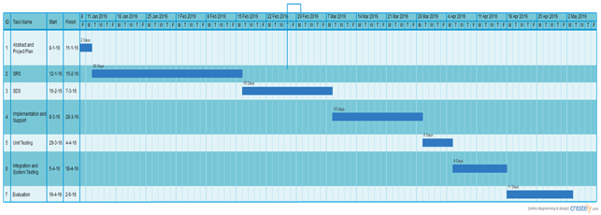
Gannt Chart

Slide 9
Use Case Diagram

Slide 10
Class Diagram

Slide 11
State Diagram

Slide 12
Date Flow Diagram

Slide 13
Activity Diagram 1/2

Slide 14
Activity Diagram 2/2

Slide 15
Sequence Diagram 1/2

Slide 16
Sequence Diagram 2/2

Slide 17
Applications
Online registration of FIRs.
Online registration and payment of fines.
Viewing and updating of a Criminal Database.
Easy communication between various police departments.
Passport verification with a two tier confirmation system.

Slide 18
Advantages
Affordability
Convenience
Efficiency and Flexibility
Secure Data Communication
Increased Cooperation and Networkability
Crime Reduction and increased Safety and Security

Slide 19
Screenshots

